Slide 1

Internet of Things Project using Python (CSE 4110) Project Presentation on
Volatile Organic Compound Detection System Using Thingspeak
Supervisor
Prof. Dr. Farida Ali
Prof. Dr. Gaurav Yadav
Presented by
Anand Bhattacherjee
Snigdha Panda
Department of Computer Science and Engineering
Institute of Technical Education & Research (FET)
Siksha ‘O’ Anusandhan Deemed to be University, Bhubaneswar
January, 2024

Slide 2
Contents
Introduction
Literature Survey
Design Scheme
Tools Used
Testing
Socio-Economic Issues Associated With The Project
References
Conclusion

Slide 3
Introduction
In recent years, growing concerns about environmental pollution and its impact on human health have prompted the development of advanced monitoring systems. Volatile Organic Compounds (VOCs) are a group of pollutants emitted from various sources, including industrial processes, vehicle exhaust, and household products. Monitoring and controlling VOC levels are crucial for maintaining air quality and minimizing health risks.
This project introduces a Volatile Organic Compound Monitoring System that leverages Thing-Speak, an Internet of Things (IoT) platform, to collect, analyze, and visualize real-time data on VOC concentrations. Thing-Speak provides a user-friendly interface and cloud-based infrastructure, making it an ideal platform for remote monitoring and management.

Slide 4
Literature Survey
[1] Jiamei Huang and Jayne Wu, “This work aims to detect volatile organic compounds (VOC), i.e., acetone, ethanol and isopropyl alcohol (IPA) and their binary and ternary mixtures in a simulated indoor ventilation system. Four metal-oxide-semiconductor (MOS) gas sensors were chosen to form an electronic nose and it was used in a flow-through system. Five parameters were extracted including three in phase space and two in time space.
[2] Jungmo Ahn and Hyungi Kim, "Improvements in small sized sensors allow the easy detection of the presence of Volatile Organic Compounds (VOCs) in the air using easy-to-deploy Internet of Things (IoT) devices. However, classifying what VOC exists in the environment still remains as a complex task. Knowing what VOCs are in the air can help us remove the main cause that vents VOC materials as a way to maintain clean air quality.

Slide 5
[3] Aline Mara Oliveira and Aniel Silva Morais, "The solution proposed in this article uses an odor source identification strategy, employing a gas distribution mapping approach in a three-dimensional environment. The aim of the study was to investigate the feasibility and effectiveness of this approach for detecting gases in areas that are difficult to access or dangerous for humans. The results obtained show that the use of drones equipped with gas sensors is a promising alternative for the detection and monitoring of gas leaks in closed environments.
[4] Elyn See and Toh Yong Sen, "We aim to eliinate this problem by putting in place a system that continuously monitors the presence of contaminants at locations where used water is usually discharged into the waterways. In Singapore, another important source of water is the reclamation of used water through numerous water treatment processes. To protect our used-water network, this system monitors and detects the discharge of Volatile Organic Compounds (VOCs), such as benzene, toluene and xylene, into the network.

Slide 6
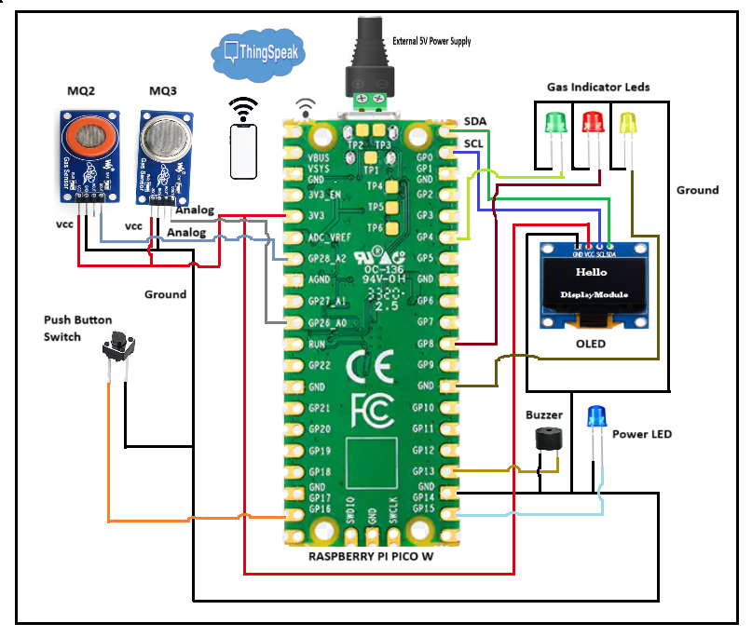
Design Scheme
Hardware :
Sensors : The MQ2 sensor is use to monitor the concentration of compounds like propane, Butane, while the MQ3 sensor monitors compounds like alcohol, smoke.
Raspberry Pi Pico W : The Raspberry Pi Pico W is a microcontroller which helps to execute the code and take reading from the sensors and even sends data wirelessly through its built-in Wi-Fi.
Display : We have used OLED to display the data and indicate if any compound is detected.
Cloud Connection: All the data gets sent to Thing-Speak, a friendly cloud platform. It stores our weather history and lets us access it from anywhere, anytime.

Slide 7
Tools Used
Tools Used :-
Thonny Editor
Micro-python
Raspberry Pi Pico W
MQ2 Sensor
MQ3 Sensor
OLED Driver

Slide 8
Testing
Testing a Volatile Organic Compound (VOC) monitoring system using Thing-Speak involves verifying the functionality, reliability, and accuracy of the system. Here is a general guideline for testing such a system:
Sensor Calibration:
Before testing, ensure that VOC sensors are properly calibrated according to the manufacturer's guidelines.
Conduct a calibration process to establish a baseline for accurate measurements.
Hardware Integration:
Connect the VOC sensors to the microcontroller or single-board computer (e.g., Arduino, Raspberry Pi).
Thing-Speak Configuration:
Set up a Thing-Speak account and create a channel for the VOC monitoring system.
Configure the Thing-Speak channel with the appropriate fields for VOC concentration data.
Data Transmission:
Implement the code on the microcontroller to read data from the VOC sensors and send it to Thing0-Speak.
Monitor the Thing-Speak channel to verify that data is being transmitted and updated in real-time.

Slide 9
Real-time Monitoring:
Access the Thing-Speak platform through the web interface or mobile application to observe real-time VOC concentration data.
Check for any delays or issues in the data update frequency.
Threshold Alerts:
If an alert system is implemented, test the threshold functionality.
Introduce simulated high VOC concentrations to ensure that the alert system triggers notifications appropriately.
Data Analysis:
Explore the data analysis tools provided by Thing-Speak to review historical trends and patterns.
Check if the system accurately captures and represents variations in VOC concentrations over time.
User Interface:
Evaluate the user interface of the Thing-Speak platform for ease of use and clarity.
Ensure that users can access and interpret the VOC data effectively.
Error Handling:
Implement error-handling mechanisms in the system to manage unexpected events, such as sensor malfunctions or internet connectivity issues.
Test the system's response to simulated errors to ensure graceful degradation.

Slide 10
Result Analysis
4.1. Testing Criterions
4.1.1. Relevance
Objective Alignment:
Test Objective:
Verify that the system aligns with the project's core objectives.
Evaluation Process:
Cross-reference the system functionalities with the initially defined project objectives.
Assess whether the system effectively provides real-time gas-level using onboard sensors.
Example:
Scenario:
Project Objective: Provide real-time gas-level using onboard sensors.
System Functionality: Sensors accurately measure and display concentration of alcohol, propane, smoke, LPG.
Evaluation Outcome:
If the system fails to display accurate or real-time data, adjustments are made to sensor calibration or data processing algorithms.
Reassess and validate relevance through iterative testing to ensure alignment with project objectives.

Slide 11
4.1.2. Effectiveness
Sensor Accuracy:
Test Objective:
Assess the accuracy of sensor readings compared to actual environmental conditions.
Evaluation Process:
Conduct testing in controlled environments with known conditions.
Compare sensor readings (concentration of alcohol, propane, smoke, LPG) against calibrated reference values.
Example:
Scenario:
Project Objective: Real-time weather monitoring.
System Functionality: Sensors accurately measure environmental parameters.
Evaluation Outcome:
If inaccuracies are identified, refine calibration parameters in Micro-Python scripts.
Optimize sensor integration for improved accuracy based on testing outcomes.

Slide 12
Real-Time Updates:
Test Objective:
Evaluate the system's effectiveness in providing real-time gas-level updates.
Evaluation Process:
Introduce changes in environmental conditions and assess the speed of system response.
Monitor the delay between sensor readings and updates on the OLED display.
Example:
Scenario:
Project Objective: Gas-level monitoring.
System Functionality: Updates on the OLED display should reflect changes in environmental conditions without significant delays.
Evaluation Outcome:
If there is a noticeable lag between sensor readings and display updates, adjustments are made to the data processing logic.
Continuous testing ensures that the system remains effective in providing real-time updates.

Slide 13
Socio-economic Issues Associated With The Project
Implementing a Volatile Organic Compound (VOC) monitoring system using Thing-Speak, or any environmental monitoring system, can have socio-economic implications that should be considered. Here are some potential socio-economic issues associated with this project :
Public Health Impact:
Positive Impact: Improved air quality monitoring can lead to better public health outcomes by reducing exposure to harmful VOCs, which may result in fewer respiratory issues and related health costs.
Negative Impact: If the monitoring system reveals high levels of VOCs, it may raise public concerns and potentially impact property values in affected areas. It could also lead to increased healthcare costs for addressing related health issues.
Economic Costs:
Initial Investment: The deployment of monitoring systems involves initial costs for hardware, sensors, connectivity, and platform subscriptions.
Maintenance Costs: Regular maintenance, calibration, and software updates contribute to ongoing costs.
Economic Benefits: Improved air quality can, in the long run, lead to economic benefits by reducing healthcare costs and increasing overall productivity due to a healthier population.

Slide 14
Community Awareness and Engagement:
Positive Impact: Increased awareness of environmental issues can empower communities to advocate for cleaner air and sustainable practices.
Negative Impact: Lack of community engagement or understanding of monitoring results may hinder the effectiveness of the project.
Data Privacy and Security:
Concerns: Monitoring systems involve collecting and transmitting data. Ensuring the privacy and security of this data is crucial to prevent misuse or unauthorized access.
Public Trust: Any breaches or perceived vulnerabilities in data security can erode public trust in the monitoring system.
Equity and Environmental Justice:
Unequal Exposure: Vulnerable populations may be disproportionately exposed to high levels of VOCs. The monitoring system should consider the equitable distribution of monitoring stations to address environmental justice concerns.
Access to Information: Ensuring that all communities have access to the information generated by the monitoring system is essential for promoting equity.
Technological Divide:
Access to Technology: Unequal access to technology and the internet may result in certain communities being excluded from the benefits of the monitoring system.
Digital Literacy: Ensuring that users in all demographics are digitally literate and can effectively use the monitoring system is important for its success.

Slide 15
References
[1] Jiamei Huang and Jayne Wu, “This work aims to detect volatile organic compounds (VOC), i.e., acetone, ethanol and isopropyl alcohol (IPA) and their binary and ternary mixtures in a simulated indoor ventilation system.
https://www.mdpi.com/2227-9040/8/3/73
[2] Jungmo Ahn and Hyungi Kim, "Improvements in small sized sensors allow the easy detection of the presence of Volatile Organic Compounds (VOCs) in the air using easy-to-deploy Internet of Things (IoT) devices.
https://www.sciencedirect.com/science/article/abs/pii/S1570870520307058
[3] Aline Mara Oliveira and Aniel Silva Morais, "The solution proposed in this article uses an odor source identification strategy, in a three-dimensional environment.
https://www.mdpi.com/2504-446X/7/11/660

Slide 16
Conclusion
In conclusion, the Volatile Organic Compound Monitoring System using Thing-Speak offers an effective and user-friendly solution for monitoring air quality in real-time. By leveraging IoT technologies, this system contributes to environmental sustainability and public health by providing valuable insights into VOC concentrations.

Slide 17
Thank You

